Slide 1
SDM Core team Sacramento March 18, 2015

Slide 2
Today
SDM 3
Introductions
CRC – Peggy Cordero and Lynnā McPhatter-Harris
County reps
The tool revisions and context with practice model integration and research
Considerations and context for tool review throughout the day
When to implement - options
Planning and needs support for dissemination and training
Planning for curriculum updates
Review of each tool including
Overview of key changes to the tool
Link to practice and engagement with families
30 minutes and can be flexible
A deeper look at Web SDM upgrades and planning
The SDM Report – changes to format and content

Slide 3
Why Update the SDM assessments?
Better Decisions and Outcomes for Children & Families
Last major workgroup development 1999;
Only minor changes and updates since
Address known issues; Response Priority for example
Practice has evolved since 1999
Stronger integration of tools in fill and balanced assessment process

Slide 4
Implementation and WebSDM
Considerations
WebSDM will be upgraded in the next contract year
Planned Changes; some within existing version
New look and feel in both current version and upgraded
Support for modern browser features
When thinking changes in look and feel, think SM4 to SM5
What will it take to implement WebSDM with a new look and feel?
Workers difficulty with adjusting? Significant, Moderate Minor?
New functionality in upgraded version, such as:
enhancing security with sign on procedures similar to SM5,
use on phones and tablets,
strengthening the platform and
allowing new possibilities for information linking
Preparation for upgrade will include outreach by WebSDM design team with counties to solicit ideas and desires

Slide 5
Implementation Considerations and WebSDM
WebSDM will be upgraded in the next contract year
Planned Changes; some within existing version
New functionality in upgraded WebSDM:
strengthening the platform;
enhanced security; sign on procedures similar to SM5;
use on phones and tablets;
allows new possibilities for information linking; and
Preparation for upgrade will include outreach by WebSDM design team with counties to solicit ideas and desires
New look and feel in existing and upgraded version
Support for modern browser features,
No changes in function
When thinking changes in look and feel, think SM4 to SM5
What will it take to implement WebSDM with a new look and feel?
Workers difficulty adjusting: Significant, Moderate or Minor?

Slide 6
Implementation Considerations and WebSDM
2 Phases or 1
2 Phase
Incorporate SDM 3 into current WebSDM but only with new look and feel; then upgrade
If tools are finalized, SDM 3 available in early July, 2015
Would provide about 2 to 2.5 months for SDM 3 and WebSDM training
Upgrade and introduce upgrade in 1st 3 months of 2016
Would require 2 WebSDM trainings
1 Phase
Incorporate SDM 3 into upgraded version of WebSDM with enhanced functionality and security and new look and feel
This would be an October 1, 2015 rollout
Would require 1 training of WebSDM changes
Would allow three additional months of preparation for implementation of SDM 3

Slide 7
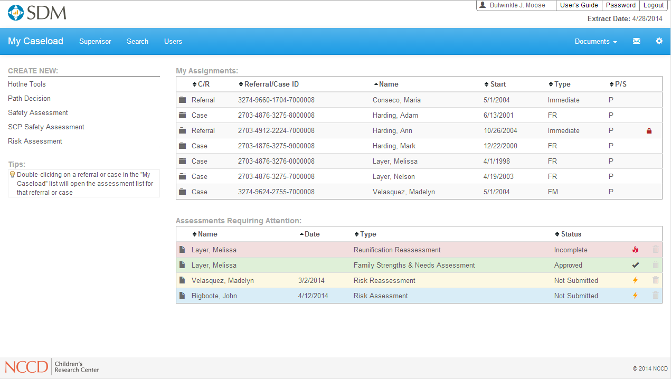
Notes:
Home Page – My Caseload

Slide 8
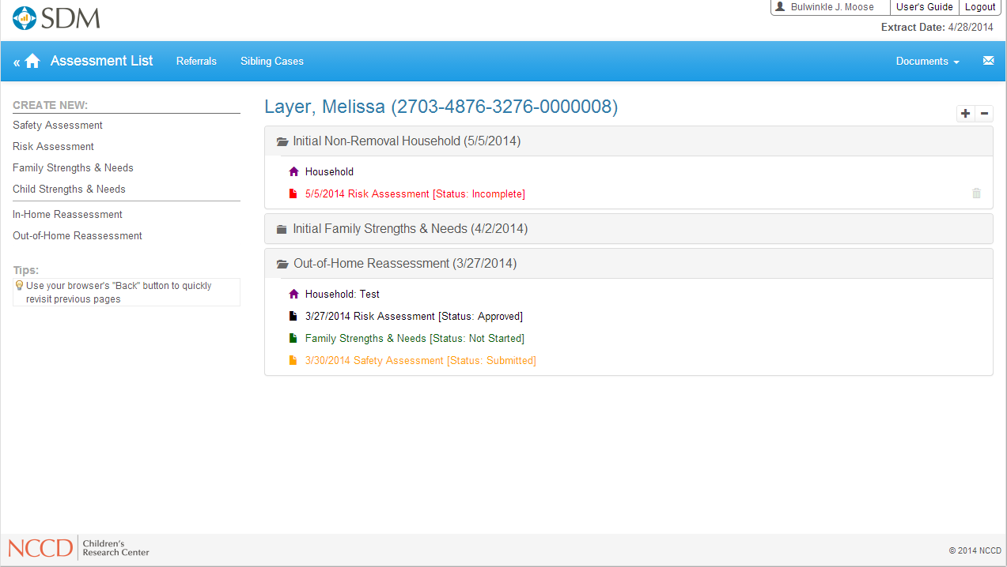
Notes:
Case Assessment List

Slide 9
Updating SDM Curriculum
Foundational | Responsible for Revisions | Next Steps/Time frame
Basic Two-Day Orientation | CRC | Prior to release
Supervisory Modules | CRC
Advanced Modules:
Interviewing for the Hotline | CRC
Interviewing for the Safety Assessment | CRC
Safety Planning | CRC
Interviewing for the Family Strengths and Needs Assessment | CRC
Case Planning | CRC
Dev
California/RTA Curricula
Structured Decision Making and Critical Thinking in Child Welfare Assessment
Common Core 3.0 Assessment Block eLearning, classroom and coaching
Adapted RTA curriculum that may include copies of tools as part of skill building
Other

Slide 10
Hotline
Screening Criteria

Slide 11
Physical Abuse Criteria
Major Changes
Review of Criteria Not Required moved to beginning of assessment and defined
Physical Abuse – Substantial Changes
Caregiver action that caused or will cause injury generally replaces threats of physical abuse and excessive discipline and more clearly provides a focus on actions by the caregiver and impact on child
Includes physical harm as result of Domestic Violence
Emotional Abuse - Substantial Changes
Caregiver actions have led or are likely to lead to…… provides a stronger focus on actions by the caregiver and impact on the child
Exposure to Domestic violence has the same purpose and impact
Above combined removes the need for Threat of Emotional abuse

Slide 12
Sexual Abuse Criteria
Continued
Sexual Abuse
“Physical, behavioral, or suspicious indicators consistent with sexual abuse” was added under “sexual abuse.”
Commercially Sexually Exploited And/Or Sex Trafficked
Sexual Exploitation definition expanded to specifically include a child being commercially sexually exploited and/or sex trafficked by or with knowledge and consent of caregiver.
To Neglect, Failure to Protect
A child has been exploited by a third party, and the person responsible for the child’s care has failed in protecting or been unable to protect the child from being commercial sexually exploited and/or sex trafficked. This includes situations where the person responsible for the care of the child has been coerced or otherwise been unable prevent exploitation.

Slide 13
Commercial Sexual Exploitation or Sexually Trafficked
Tracking information for Commercially Sexually Exploited and/or Sex Trafficked
Commercially Sexually Exploited and/or Sex Trafficked Information
Check when an in-person response has been indicated and the maltreatment criterion is either commercial sexual exploitation where the child is sexually trafficked or failure to protect from sexual trafficking.
Child has been commercially sexually exploited and/or sex trafficked while in placement (notify worker for immediate response and notify licensing)
Child has been commercially sexually exploited and/or sex trafficked (not in placement)—immediate placement support

Slide 14
Neglect Criteria
Severe and General Neglect
Unexplained and/or suspicious death changed to more explicit reference to death from and/or suspicious for neglect
Automatic 24 hour removed from non-organic failure to thrive and child’s health safety endangered. Targeted for override issues
Hygiene added to item on Inadequate Clothing to include an area not adequately addressed
‘Child has no parent or guardian capable of providing appropriate care’ changed to ‘Caregiver absence/abandonment’; enhanced definition to better distinguish from Inadequate supervision
Inadequate Supervision definitions enhanced with examples
Failure to protect definition adds commercial sexual……………

Slide 15
Hotline
Response Priority

Slide 16
Response Priority
Major focus – streamline and address overrides
Physical Abuse; separated out questions, refined some definitions; ordered by threat to safety
Added checkboxes for questions to enable better tracking
Changed question ‘brutal and/or dangerous’ to ‘caregiver’s behavior dangerous or threatening….’
Added whether non perpetrating caregiver is aware, supportive and displays ability to protect – removes need to determine if alleged perpetrator has access within 10 days
Emotional Abuse; refined definitions
1st question adds parental response to child’s behavior, focusing on whether the child is receiving attention
2nd question adds clarity to definition and provides more explicit focus to impact on the child

Slide 17
Response Priority
Major focus – streamline and address overrides
Sexual Abuse
Reduced questions from 3 to 2
1st question is similar
2nd question focus is on whether a non-perpetrating caregiver who is aware of the allegation, is supportive and demonstrates the ability to protect. Similar in construction to same question on Physical Abuse

Slide 18
Safety Assessment
Threats and Complicating Caregiver behaviors

Slide 19
Vulnerability / Threats / Complicating Behaviors
Changes
All changes to items and definitions to focus attention on specific actions by the caregiver and impact on child
Vulnerability – definitions added
‘School age but not attending……..’ changed to ‘Not readily accessible to community oversight’ is broader but better matches what staff see with referrals
Threats to Safety
Substance abuse and emotional stability…. that seriously impairs ability to supervise, protect, or care for the child removed as discrete threat
Two step process – the condition and the action
Actions are included in other safety threats
Focus turns to the actions and results (impact on child)

Slide 20
Vulnerability / Threats / Complicating Behaviors
Changes
All changes to items and definitions to focus attention on specific actions by the caregiver and impact on child
Domestic violence incorporated into #1 ‘serious harm or threat to cause’ and #3 ‘not meeting child’s needs’
Taken together these three result in focus on impact on the child and leads to consideration of substance abuse, emotional stability, coginitve, developmental, physical heath as considerations in safety planning
Complicating Behaviors - Anything that further complicates the work of creating safety but does not rise to the level of harm.
Conditions that make it more difficult or complicated to create safety for a child but do not create a safety threat alone. These behaviors must be considered when assessing for and planning to mitigate safety threats

Slide 21
Vulnerability / Threats / Complicating Behaviors
Changes
Changes in ordering of threats; allows focus on threats resulting from actions of caregiver
Definitions modified in some circumstances to enable greater focus on child impact
Question: Is ‘The family refuses access to the child, or there is reason to believe that the family is about to flee’ a safety threat? What is impact on child?
Rarely used – 4/10ths of a percent of all 2013 safety threats, 1.7% of assessments with an identified threat and generally only used when another threat is present
If worker cannot access a child, safety cannot be completed. Worker and supervisor would complete a warrant, safety assessment not a consideration
Identifying could only lead to safety decision of unsafe; eliminating safety planning as a possibility

Slide 22
Safety Assessment
Acts of protection and Supporting Strengths

Slide 23
Considerations for Safety Planning
Child Vulnerabilities
Existing Action of Protection
Household Strengths
Household Complicating Factors

Slide 24
HOUSEHOLD STRENGTHS AND PROTECTIVE ACTIONS
Replaces Protective Capacities
Household Strengths: Resources and conditions that increase the likelihood or ability to create safety for a child but in and of themselves do not fully address the safety threats.
Protective Actions: These are specific actions, taken by one of the child’s current caregivers or by the child, that mitigate identified safety threats in the household.
Household strengths and protective actions should be assessed, considered, and built upon when creating a safety plan. Mark all that apply to the household
Why? Separates strengths and actions, allowing for a m ore directed assessment when determining to implement a safety plan and when to remove

Slide 25
Safety Assessment
Safety Interventions and Safety Decision

Slide 26
Safety Interventions and Safety Decision
Reorganization of decisions and definition clarification
Safety Decisions now follow specific sections based on identification of threats, supporting strengths and protective actions. Paralells presentation in WebSDM.
Safety interventions divided into in home interventions and placement interventions
‘Use of family, neighbors, or other individuals in the community as safety resources’ definition refined to better indicate short term family placement
‘Have the caregiver voluntarily place the child outside the home, consistent with WIC 11400(o) and (p)’ definition refined to better indicate when used
Safety Decision – Now termed Safe, Safe with Plan and Unsafe

Slide 27
Risk Assessment
Validation and Practice Driven Changes

Slide 28
Initial Risk Assessment
Major Changes
Single Stream Presentation in WebSDM
Reduction in common errors (prior investigations, prior open cases)
Reduction in discrete # of items
Allows grouping of items by content area
prior investigations details,
current investigation details
family characteristics
Item Language and Definitions
Switch from ‘Score’ this item to identify and choose
Neutral language in most items

Slide 29
PRIOR INVESTIGATIONS | Neglect | Abuse
1. Prior Neglect Investigations
○ a. No prior neglect investigations | 0 | 0
○ b. One prior neglect investigation | 0 | 1
○ c. Two prior neglect investigations | 1 | 1
○ d. Three or more prior neglect investigations | 2 | 1
2. Prior Abuse Investigations
○ a. No prior abuse investigations | 0 | 0
○ b. One prior abuse investigation | 1 | 0
○ c. Two prior abuse investigations | 1 | 1
○ b. Three or more prior abuse investigations | 1 | 2

Slide 30
Initial Risk Assessment
Major Changes
Validation driven changes
Many items are for both primary and secondary
Mental health (A & N)
Hx of abuse or neglect (A & N)
Alcohol or Drug Use (A & N)
Criminal Hx. (N)
Items Removed
Physical care of child from N
Primary Caregiver domineering from A
Reduced weight
prior investigations
child characteristics
Separated Prior Open Case into past open and closed and past open and remains open

Slide 31
Strengths and Needs
Family and Child

Slide 32
Family
Major Change:
New Domain Format
Actively help create safety, permanency, and child/youth/young adult well-being.
Are not strengths or barriers for safety, permanency, or child/youth/young adult well-being.
Are barriers to safety, permanency, or child/youth/young adult well-being.
Contribute to imminent danger of serious physical or emotional harm to the child/youth/young adult.

Slide 33
Family
Major Change:
New Domain Format
Focused on safety, permanency, and child/youth/young adult well-being as a continuum.
Structuring the responses in this manner should aid in communicating concerns and strengths in understandable terms to those who are involved with and/or care about the child.
Assists in clear case plans and measuring progress.
Better ability to look at movement between levels
Distinguishes between a barrier
Provides continuity with other SDM assessments that emphasize behaviors and their impact on the child.

Slide 34
Family
Major Changes:
No point values – Change in structure removes the need for differential points to aid in prioritization
D choices are always a priority’ while C choices may be prioritized
D choices are equivalent to Safety threat and should be identified as well
New Domains
Trauma
Family Violence and Domestic Violence
Cognitive/Developmental Abilities
Cultural item is removed and replaced by….

Slide 35
Family
Cultural Identity
Greater focus on Cultural
Consideration of whether the caregiver’s perspective of culture and cultural identity
helps to create safety, permanency, and child/youth/young adult well-being;
is not a strength or barrier for safety, permanency, or child/youth/young adult well-being;
is a barrier to safety, permanency, or child/youth/young adult well-being; or
presents an imminent danger of serious physical or emotional harm to the child/youth/young adult.

Slide 36
Child
Major Changes
Addition of the “Household Context” item at beginning of the assessment for similar reasons as mentioned for the caregiver portion.
Similar A through D structure but not always
11 defined domains and “other” in SDM 3.0.
Cultural identity was removed as a domain, allowing a more thorough evaluation of culture and the child.
“Trauma” was added as a domain.
For children in placement only, “Relationship With Substitute Caregiver” was added as a domain.
An independent living domain has been added that must be completed for youth age 15.5 or older.

Slide 37
Risk Reassessment
Validation and Practice Driven Changes

Slide 38
Risk Reassessment
Major Changes
Item Language and Definitions
Switch from ‘Score’ this item to identify and choose
Neutral language in most items
Mental Item changed to similar format and weights as substance abuse
Caregiver progress item matches format of reunification progress
Definition similar but weights different on progress
Validation Driven Changes
Prior Investigations changed in counting priors and weights
New investigation during review period has increased weight

Slide 39
R8. Primary caregiver mental health since the last assessment/reassessment (mark one)
a. | ◻ | No history of mental health problem | 0
b. | ◻ | No current mental health problem; no intervention needed | 0
c. | ◻ | Yes, mental health problem; problem is being addressed | 0
d. | ◻ | Yes, mental health problem; problem is not being addressed | 1

Slide 40
Reunification Reassessment
Risk Reassessment

Slide 41
Reunification Risk
Progress Item
Definition:
changed to emphasize behaviors and the demonstration of behaviors that reduce risk of subsequent harm to a child.
While participation in services remains a factor, the definitions have a much stronger emphasis on behavioral change that will aid the family in creating and maintaining safety.
Moved from policy to definitions section
Added definitions for Policy overrides

Slide 42
Reunification Reassessment
Visitation Evaluation

Slide 43
Visitation Evaluation
Changes
Simplified table so Strong/Adequate is in 1 column and Limited/Destructive is the other column
Definitions re-written with increased focus on parental behaviors during visits
Moved definitions from paper form to definitions section

Slide 44
Reunification Reassessment
Safety

Slide 45
Safety
Major Changes
Changed from safety assessment form to be completed to critical evaluation in narrative format. Represents specifically evaluating impact of planning on previously identified threats and emergence or continued presence of threats
Are any safety threats identified on the safety assessment that resulted in the child’s removal still present?
1a. If yes, is there a safety intervention that can and will be incorporated into the case plan to mitigate these safety threats?
2. Have any new safety threats been identified since the child’s removal or are there any other circumstances or conditions present in the reunification household that, if the child were returned home, would present an immediate danger of serious harm?
2a. If yes, is there a safety intervention(s) that can and will be incorporated into the case plan to mitigate these safety threats?

Slide 46
Safety
Other factors
Definitions for the prior threats will be available in WebSDM
Definitions changed in accordance
Safety Decisions are the same as initial safety

Slide 47
WebSDM
Changes
Tim Connell to present via GOTO Meeting

Slide 48
The SDM Annual Management Report
Changes

Slide 49
Current Report Format
Traditional report style
Focus on providing basic information about ALL SDM assessments
Lengthy text description of policy, procedures, and findings
Figures and tables to demonstrate findings
Short discussion of findings at the end

Slide 50
Current Report Process
Complete assessments and enter data
Generate lengthy report
Present findings
Store report on shelf

Slide 51
Revised Report Format
Streamlined presentation
Focus on findings related to most important SDM-related issues
Focused figures and tables to demonstrate main points
Increased emphasis on insights and questions related to findings
Increased emphasis on what YOU want to know

Slide 52
Revised Report Process
Input
Complete assessments
Analysis
Present some results
Next Steps
Use results to inform practice
Enter into data base
Present insights
Pose questions
Discuss implications
Ask follow-up questions

Slide 53
The ‘New’ SDM Annual report
Six Content Areas and the Combined Comparison Report
Completion Rates, Results and Overrides for Front End Assessments
Hotline (Screening Criteria and Response Priority)
Safety
Risk
SDM Screening and CWS/CMS Screening
Risk, Safety, and Case Promotion
Recurrence by SDM® Risk Level
Risk Reassessment Recommendations and Actual Closure
Reunification Assessment Recommendations and Actual Closure
Combined Comparison Report Remains the same

Slide 54
Takeaways:
The safety completion rate includes only assessments completed for allegation household safety assessments.
Completion rates when non-allegation household assessments are included, increase to 93%.
When Substitute Care Provider Safety Assessments are included, completion rate increase to 94%
Questions for Quality:
Although completion rates are high, are the assessments completed at the appropriate time during
the investigation? What review process is in place to ensure workers are using the assessments
at the appropriate time in the investigation?a

Slide 55
The Data: SDM Reunification Reassessment Results for Children in Placement in 2014
In 2014, 19,482 cases, in which the child was in out of home placement, had a completed Reunification Reassessment. For each case, reunifications – defined as placements where a child was returned to a caregiver—were examined for a 45 day follow up period after the most recent Reunification Reassessment.
Takeaways:
Reunification was recommended for 4,457 (23%) cases and 67% of those were reunified within 45 days after their Reunification Reassessment.
Of cases with reunification, 20% were cases not recommended to reunify – risk remained high or very high and/or visitation was unacceptable and or were unsafe.

